Slide 1

Online Monitoring and Supervisory System
Health Systems Strengthening Component
USAID’s MCH Program
Link: http://mns.kphealth.pk

Slide 2
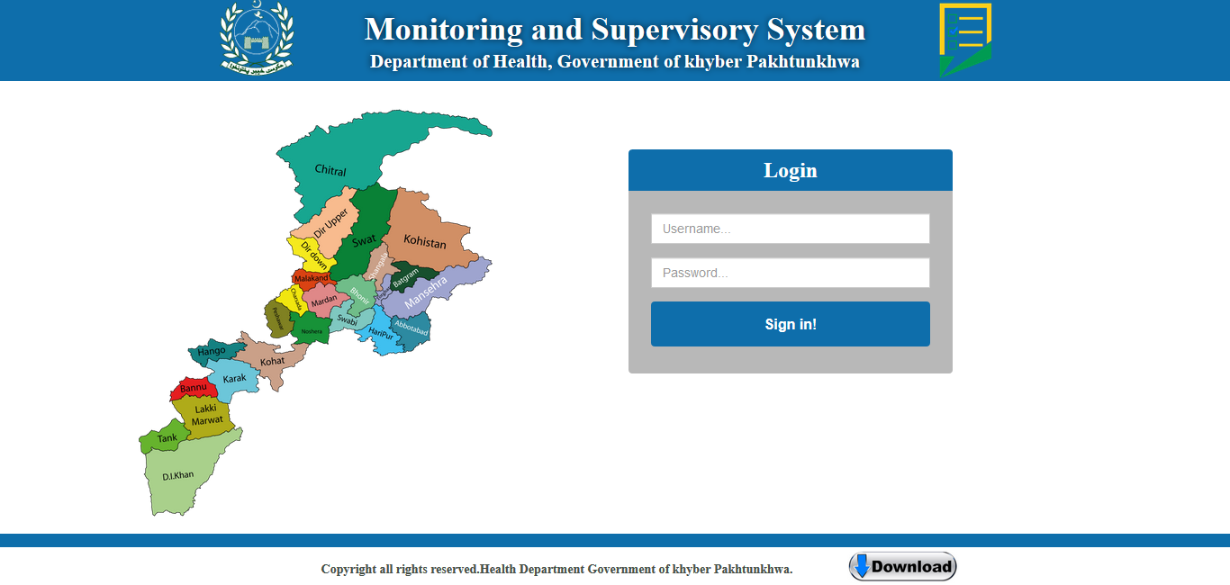

Slide 3
M&S Overview

Slide 4
Goal of Monitoring and Supervision System
To promote efficient, effective, and equitable health care delivery system
To promote quality of care at all levels of the health system by
Strengthening relationships within the system
Focusing on the identification and resolution of problems
Supervision includes quality checks of reporting and recording

Slide 5
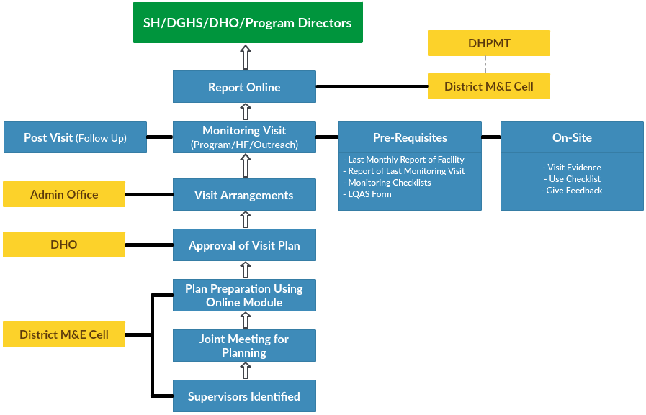
SOPs

Slide 6
Software Features

Slide 7
M&E Supervisor Checklist Software Features
District Supervisors can make their own plan online
During plan making supervisor can select Health facility to be visited, set dates of visit, select checklists to be filled
DHO may view and approved plans made by supervisor by adjusting dates, drivers and vehicles
DGHS may view the plan of all districts

Slide 8
Supervisors Team – District Level
District Health Officer
Deputy/Assistant District Health Officers
District DHIS Coordinator
Program Focal Persons of MNCH, LHW, EPI, Nutrition, TB, Malaria, Hepatitis, etc.
Any other position with special assignments such as, principal/ instructors of Nursing/public health schools

Slide 9
Supervisors Team – Provincial Level
Director General Health Services
In-charge M&E Cell
Additional Secretary Technical/ Public Health, DOH.
Chief, HSRU
Provincial program heads and monitoring officers of MNCH, LHW, EPI, Nutrition, TB, Malaria, Hepatitis, etc.
Any other with special assignments such as, Director PHDC, principal/instructors of public health schools etc.

Slide 10
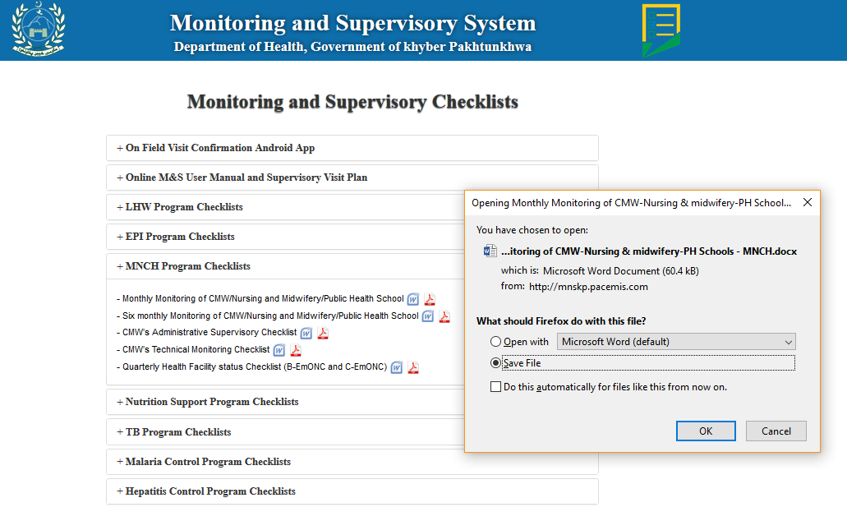
Downloadable Checklists page
File download dialog box after clicking on word or pdf icon
Downloadable Supervisory checklists
Click + to explore list of checklists in this section

Slide 11
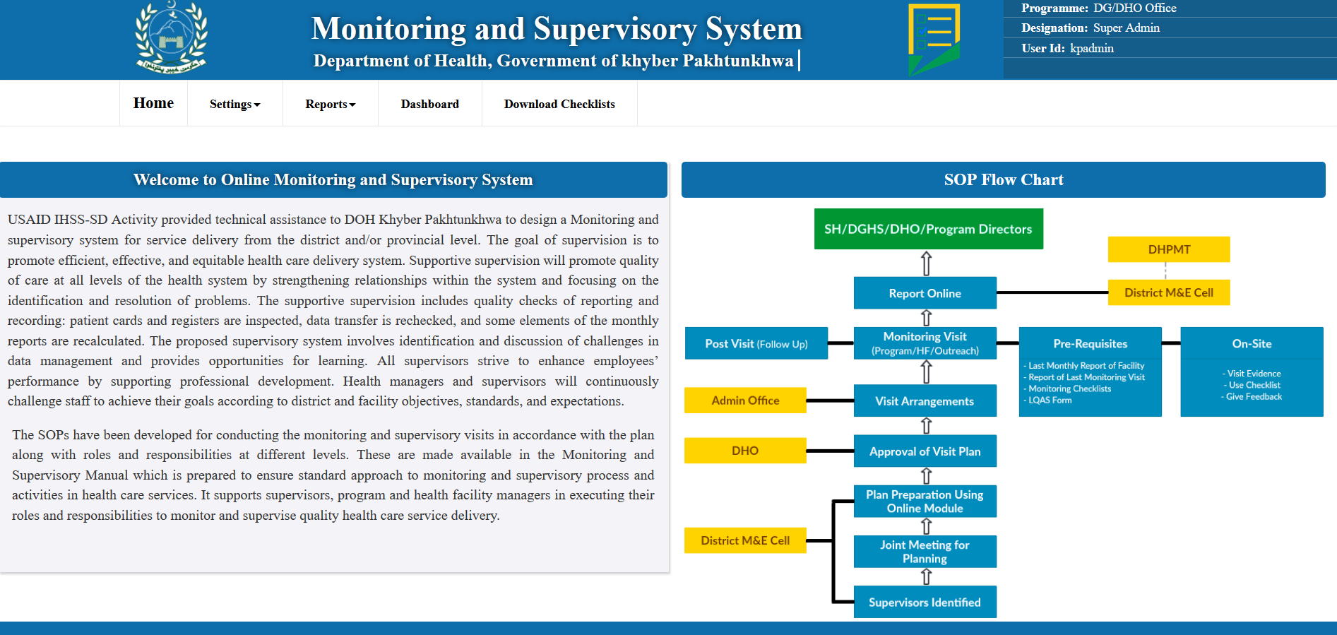
Main Interface/Screen

Slide 12
Plan Preparation
Selection of
Visit Category (DAP, Program)
Facility Type (Health Facility Type, DHO Office, CMW/Nursing School, Warehouse/store)
Facility Name
Checklist to be filled (From list of allowable checklists)
HCP Type (Health Facility, Health care provider, community work)
Date of Visit

Slide 13
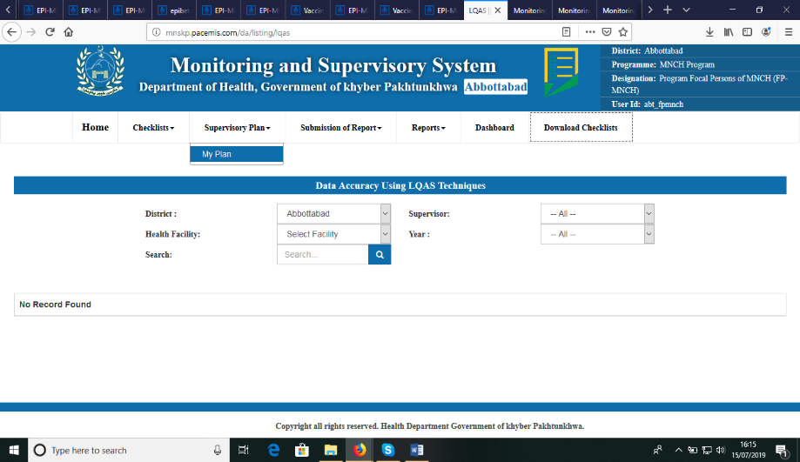
Plan Preparation
Supervisor will click on My plan to add/edit of view their plans

Slide 14
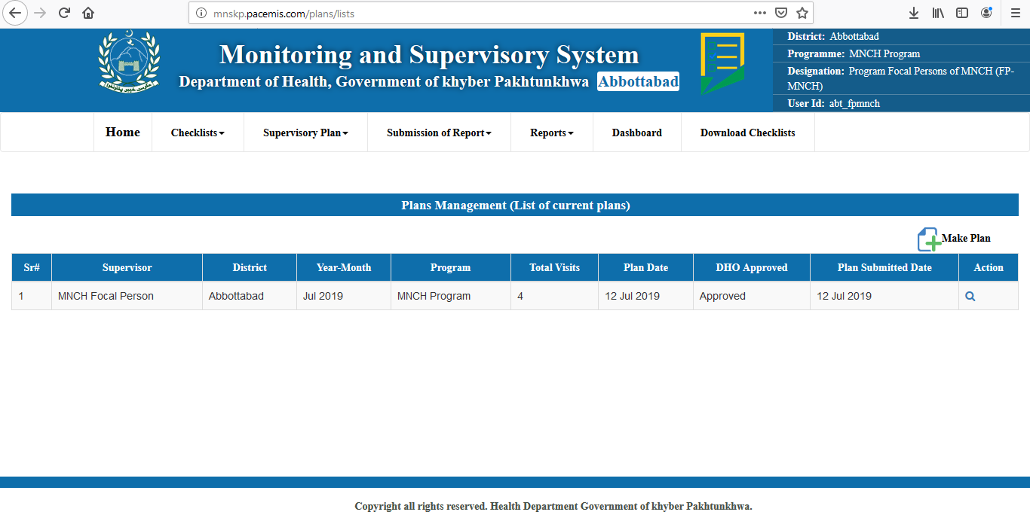
List of Plans made
Click here to make new plan
List of plans made by supervisor
Click here to see the details of plan

Slide 15
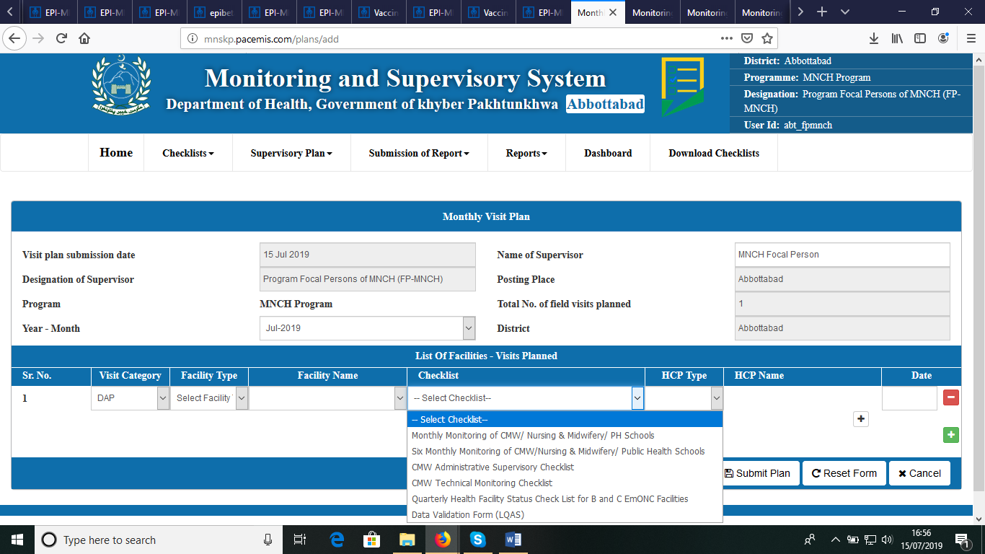
Plan Preparation in online Software

Slide 16
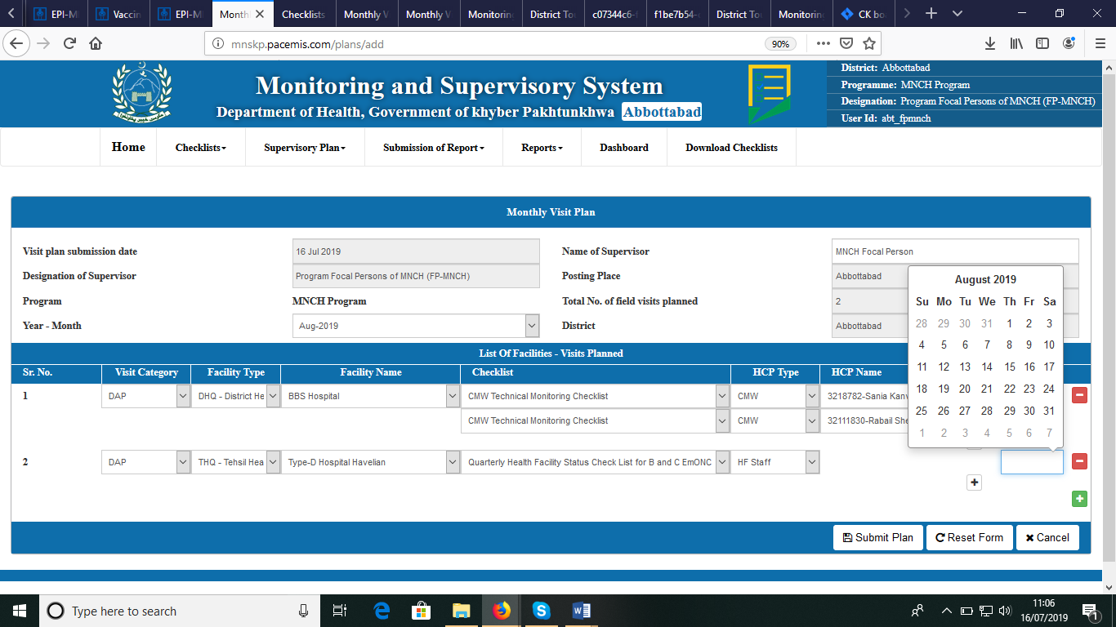
Make Plan
Date of the visit
Facility type will filter the facility of particular types
Facility to be visited
Healthcare provider to be selected whose checklists to be filled
This button allows to add new visit

Slide 17
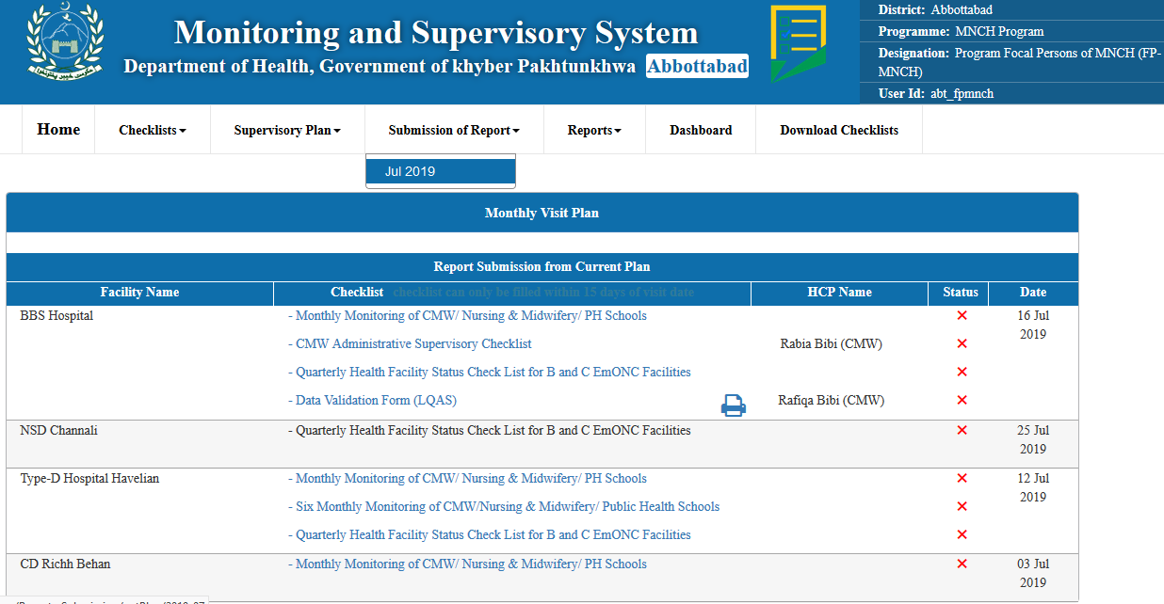
Submission of Checklists
Submission of Report List of month whose plan are available for submission
Click on checklist to enter checklist data online
“√” or “X” tells the status of checklist filled

Slide 18
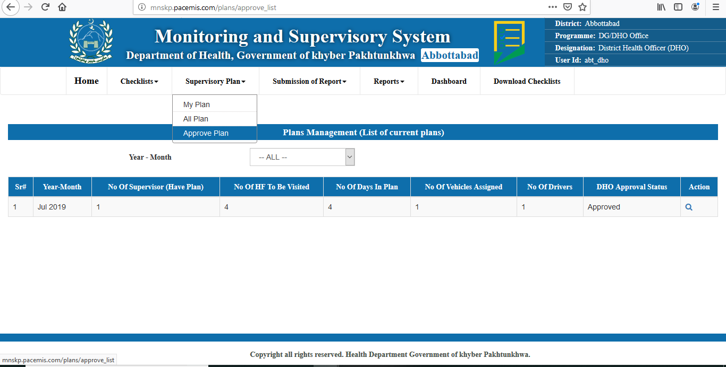
Plan Approval by DHO
DHO Login
Approve Plan

Slide 19
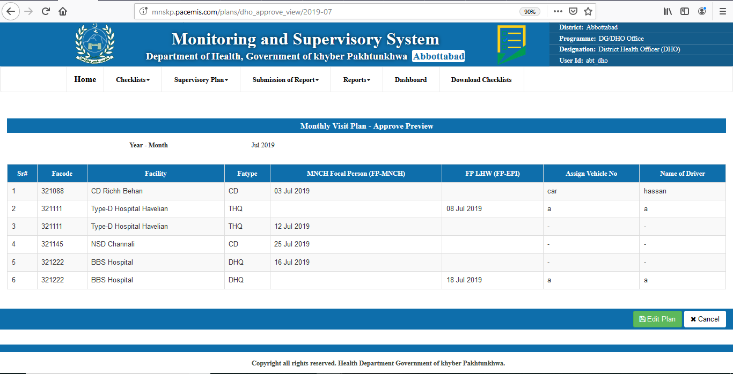
View plan for Approval
Dates of Supervisor may be adjusted by DHO to optimize the plan
DHO may Edit the existing plan

Slide 20
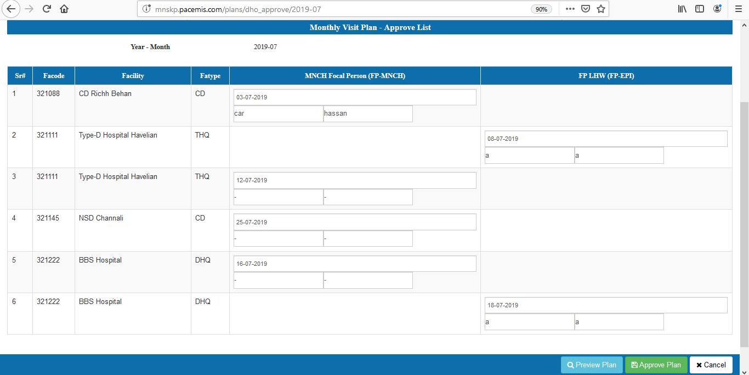
Plan Approval by DHO in Online S/W
DHO will click this button to finalize and approve Plan

Slide 21
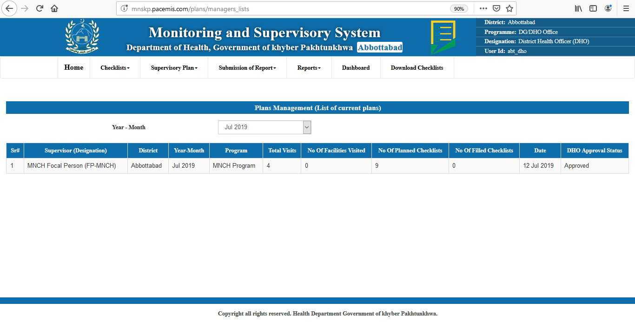
All Plan View DHO may have view of all plans by clicking All Plan in menu of Supervisory Plans
Clicking on any row will give drill down plan view of any supervisor

Slide 22
Thank You

